Slide 1
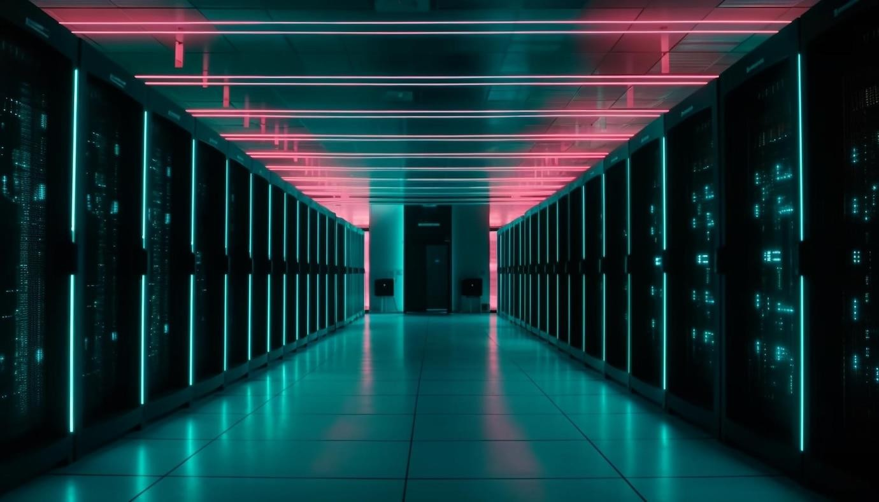
INTRODUCTION TO SERVERLESS
ARCHITECTURE
Simplify your development and operations
[Suresh and 12/06/2024]

Slide 2
INTRODUCTION TO SERVERLESS ARCHITECTURE
Don’t think Serverless means no servers
Definition: Building and running applications without managing servers called as Serverless.
Cloud providers handle the infrastructure.
🢝 Example :- - AWS Lambda, Azure Functions, Google Cloud Functions.
Developers can Focus on writing code
🢝 Developers doesn’t need to care about
1 ) Writing code for a server
Creating a server
Maintaining a server
Deploying the server

Slide 3
SERVER-BASED ARCHITECTURE VS SERVERLESS ARCHITECTURE
Aspect | Traditional Architecture | Serverless Architecture
Infrastructure Management | Managed by the organization | Managed by the cloud provider
Scalability | Manual scaling, often over-provisioned | Automatic, event-driven scaling
Cost | Fixed costs, potential underutilization | Pay-as-you-go, cost- efficient
Deployment | Time-consuming setup, requires DevOps | Fast deployment, focuses on code

Slide 4
BENEFITS OF SERVERLESS ARCHITECTURE
Simplified Operations
🢝 The cloud provider is responsible for OS and middleware updates and security patches.
Cost Efficiency
🢝 Costs are based on actual usage. You pay for the compute time your code consumes
and the resources it uses, with no charges for idle time.
Automatic Scalability
🢝 Serverless architectures automatically scale up or down based on demand. There is no need to manually add or remove servers.
Faster Development
🢝 Developers can deploy code quickly without worrying about underlying infrastructure.

Slide 5
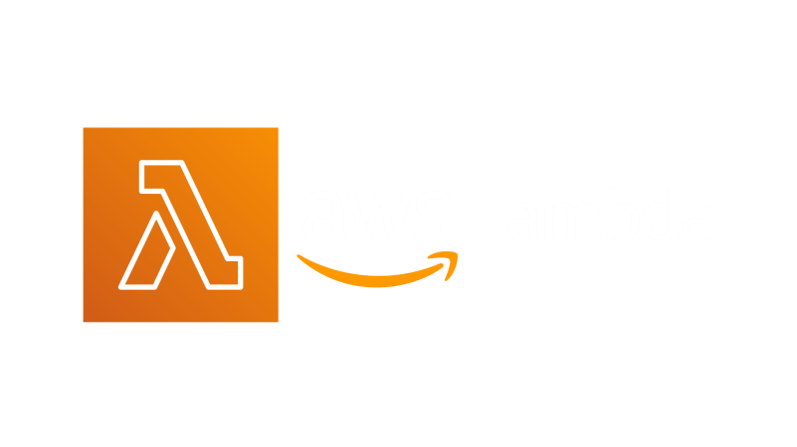
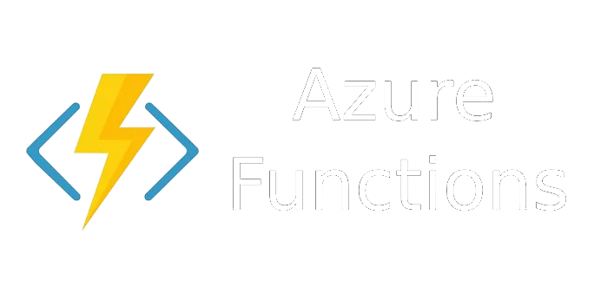

COST COMPARISION
AWS Lambda
Pricing Model: Pay-per-request and duration.
Free Tier: 1 million requests and 400,000 GB-seconds of compute time per month.
Request Pricing: $0.20 per 1 million requests beyond the free tier.
Duration Pricing: $0.00001667 per GB-second beyond the free tier
Azure Functions Pricing Model: Pay-per-request and duration.
Free Tier: 1 million requests and 400,000 GB-seconds of execution time per month.
Request Pricing: $0.20 per 1 million executions beyond the free tier.
Duration Pricing: $0.000016 per GB-second beyond the free tier
Google Cloud Functions
Pricing Model: Pay-per-request and duration.
Free Tier: 2 million invocations, 400,000 GB-seconds of compute time, and 200,000 GHz-seconds of CPU time per month.
Request Pricing: $0.40 per 1 million invocations beyond the free tier.
Duration Pricing: $0.0000025 per GB-second beyond the free tier

Slide 6
CONCLUSION
Serverless architecture simplifies development.
Focus on business logic, not infrastructure.
Automatic scaling and cost efficiency.

